Slide 1
Data Structure
NOTES

Slide 2
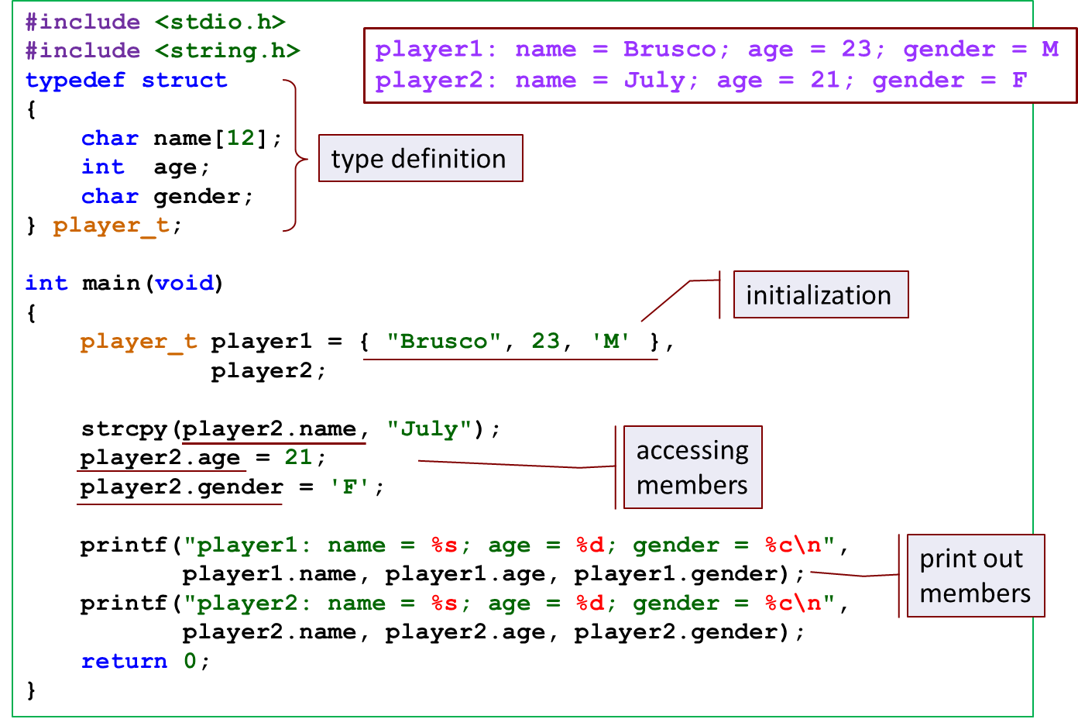
Defining Structures Data Types

Slide 3
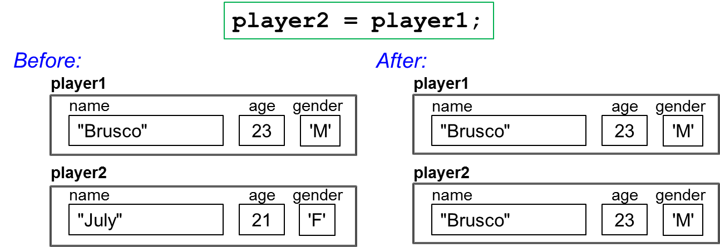
Assigning Structures

Slide 4
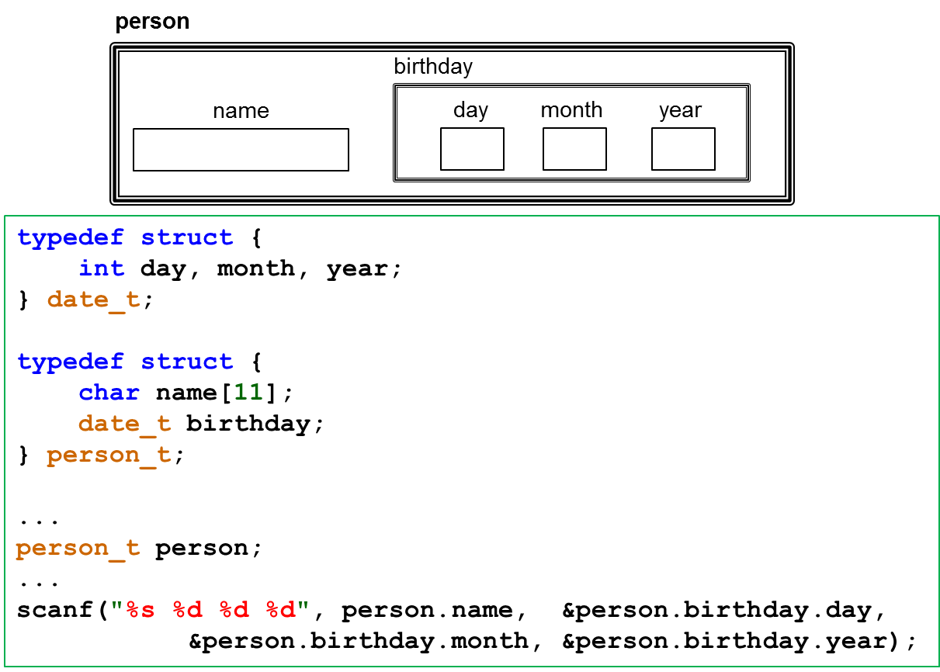
Nested Structure

Slide 5
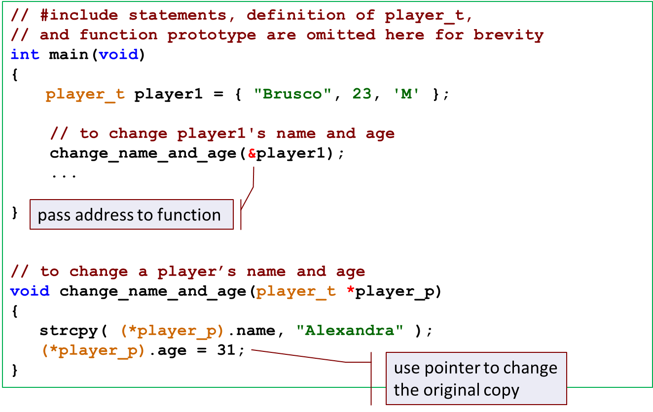
Passing to function

